Slide 1

RepiuBoss
Your Negative Reviews in Summary
FTDS-015 Group 003

Slide 2


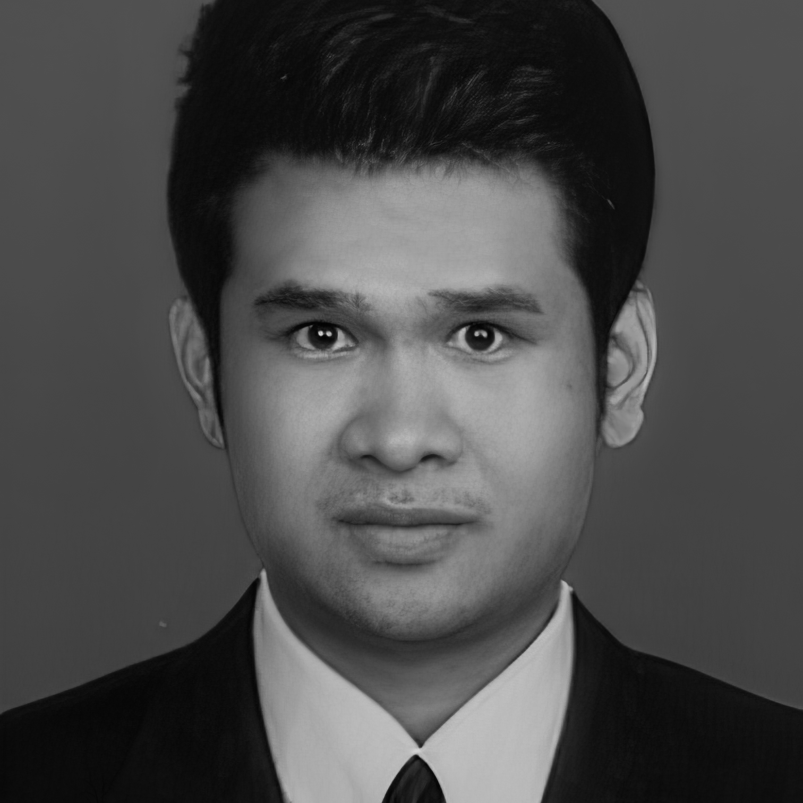
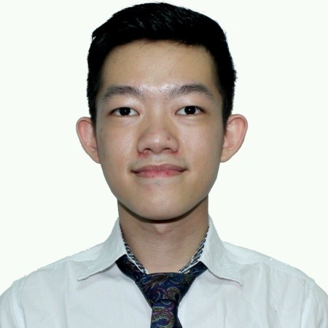



Meet Our Team
Ulul Azmi
Samuel Naiborhu
Steven Kusuma
https://github.com/ululpotter
https://www.linkedin.com/in/ululazmi94/
+62 822 8555 6634
https://github.com/kaz9112
https://www.linkedin.com/in/samuel-kristianto-97a859253
+62 818 0865 5222
https://github.com/Steven25sk
https://www.linkedin.com/in/steven-kusuma-75927613a
+62 8777 888 1996

Slide 3

TABLE OF CONTENTS
01
02
03
04
05
06
07
08
Background
Why?
Project Timeline
Model Architecture
Demo Program
Obstacles
Success Story
Further Improvements

Slide 4
Background
Doing business in Marketplace is booming right now. Only with a smartphone or laptop with an internet connection, you can buy whatever you need. Eases like this are what encourage customers to prefer products online.
But did you know that 89% of customers look for sources through the internet and see online reviews as consideration for shopping. While the other 80% of customers will change their minds to buy when they see a bad review on the product. Likewise, the difference of one star in the rating will affect sales. (inc.com)
Sometimes the seller is very difficult to read reviews from consumers one by one.
Based on this, we created RepiuBoss which helps sellers to categorise a large number of consumer reviews.

Slide 5

02. WHY RepiuBoss?
Help classify the overwhelming reviews from consumers.
Help to identify positive or negative reviews.
Easy to use.

Slide 6

03. Project Timeline
 | 19/10 | 20/10 | 21/10 | 22/10 | 23/10 | 24/10 | 25/10 | 26/10
Topic Brainstorming
Topic Finalisation, Dataset Findings and Scrapping
Exploring Dataset and Deciding on Model
Model Training
Model Deployment
Powerpoint and Demo

Slide 7

04.
Model Architecture

Slide 8

04. 01. Sentiment Reviews
TEXT PREPROCESSING
Layering
Text Vectorization
Lowercase, Removing characters, Tokenization, Slang Words
Using Artificial Neural Network as the model to process the data
Transforming text into numeric
INPUT
Splitting
Embedding
Output
Sentiment Reviews
Splitting between Corpus and Target
Second layer
Positive or Negative Sentiment

Slide 9
04. 02. Category Topic Summarisation
TEXT PREPROCESSING
CLUSTERED RESULTS
Lowercase, Removing characters, Tokenization, Slang Words, N-grams
TF-IDF
Reflecting how important a word is
Choosing output topic manually
INPUT
Bag of Words
LDA MODEL
Output
Category Reviews
Simplifying representation
Process of identifying topics in a set of documents
Topic Summarised

Slide 10

05. Demo Program

Slide 11
06. Obstacles
CHALLENGES
LIMITATIONS
New Algorithm :
The model we used is Latent Dirichlet Allocation (LDA) which is not in the syllabus.
Imputation :
Input of the reviews to the deployment app can only be made one by one.
Text Preprocessing : Indonesian words have a lot of slang words to process.
Time Constraints :
Scraping from web app is complicated and used a lot of resources.
Manual Choosing :
Choosing the topic can’t be made automatically.
Lots of Category :
Only one category because of time limitation

Slide 12
07. Success Story
Studies :
Successful in incorporating new model that have not learned before, in a short amount of time.
Output :
Model is able to differentiate between positive and negative reviews.
Results :
The outcome of the output meets our expectations
Summary :
Model is capable of summarising topic.

Slide 13

08. Further Improvements
Better Model
Explore More Categories
Integration
In the future, maybe not just focussing on the Negative reviews but Positive reviews.
There are many categories to explore in the E-commerce platform.
Automatically integrate to the E-commerce of the customer’s product reviews.

Slide 14

THANKS!
Do you have any questions?
repiuboss@gmail.com
+62 822 8555 6634 ( Ulul )
+62 818 0865 5222 ( Samuel )
+62 8777 888 1996 ( Steven )
https://huggingface.co/spaces/kaz9112/RepiuBOSS
https://github.com/RepiuBoss
@RepiuBoss
facebook.com/repiuboss

